Slide 1
Accessibility
Advanced Android Development
Lesson 6
This work is licensed under a Creative Commons Attribution 4.0 International License.

Slide 2

6.1 Accessibility
Make your app usable by everyone

Slide 3
Contents
About accessibility
App layout and organization
Content labels and descriptions
Best practices for design
Audio and video
Testing for accessibility

Slide 4
About accessibility
Enable all users, including those with disabilities, to use your app

Slide 5
About accessibility
Goal: enable all users, including those with disabilities, to use your apps
Android framework provides accessibility features for your apps
Design, code, and test your app with accessibility in mind

Slide 6
Accessibility features in Settings
Android > Settings > Accessibility
Google TalkBack: Interact using touch and spoken feedback
Select to Speak: Spoken feedback only at certain times
Switch Access: Alternative to using touchscreen (using switch or keyboard)
Voice Access app: Control with spoken commands (English only)

Slide 7
More accessibility features in Settings
Google BrailleBack: Connect a refreshable braille display via Bluetooth (available in Google Play)
Adjust the display size or font size
Use magnification gestures to temporarily zoom or magnify
Use high-contrast text, color inversion, and color correction
Turn on captions and specify closed captioning options

Slide 8
App layout and organization
Designing clear layouts with distinct calls to action

Slide 9
Guidelines for layout (1)
Avoid complex layouts and cluttered screens
Users with low vision may have trouble
Too many views = difficult to navigate with screen reader
Place items on screen according to level of importance
Important actions at top or bottom
Ensure that key items stand out

Slide 10
Guidelines for layout (2)
Use Material Design Usability – Accessibility guidelines for toolbars, menus, action buttons, etc.
Group related items together on screen in proximity to each other

Slide 11
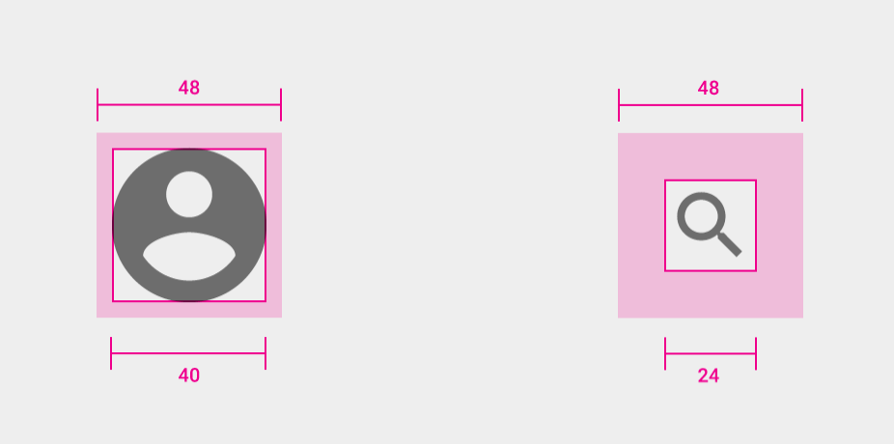
Touch targets
Parts of screen that respond to user input
Target extends beyond visual bounds of element
Touch targets should be at least 48 x 48 dp
Icon is 24 x 24 dp but target is full 48 x 48 dp, including padding

Slide 12
Selection and focus
Users who don't touch can use separate input device such as a keyboard, mouse, or TalkBack screen reader
User can move indicator such as highlight or colored box from view to view on screen
Highlighted view is considered selected or focussed
User can then activate view by pressing key or button
Standard Android views: No need to do anything but test

Slide 13
Test selection and focus
Add all views
Test whether views can receive focus (focusable)
Test focus order of views in each activity
Most (not all) Android views are focusable by default
ImageView objects are not focusable (not described in TalkBack)
Add focusable attribute to make view focusable

Slide 14
Add focusable attribute
Use focusable attribute in XML layout
<ImageView
android:id="@+id/image_partly_cloudy"
android:layout_width="200dp"
android:layout_height="160dp"
app:srcCompat="@drawable/partly_cloudy"
android:focusable="true" />

Slide 15
Order in which views get focus
Android figures out focus order
Usually left to right, then top to bottom
Avoid changing default Android focus order
If necessary, you can change default focus
Use nextFocusDown, nextFocusLeft, nextFocusRight, nextFocusUp, and nextFocusForward attributes
Specify which view should get focus next after current view

Slide 16
Example: Set view as next selection
<Button
android:id="@+id/button1"
android:layout_alignParentTop="true"
android:layout_alignParentRight="true"
android:nextFocusForward="@+id/editText1"
... />

Slide 17
Content descriptions
Describe the meaning and purpose of each UI element

Slide 18
Content descriptions
Views that don't contain text need descriptions
ImageView and ImageButton
Button with text that doesn't describe action needs description
Add description
Static view with android:contentDescription in layout
android:labelFor for view that serves as content description for another view
Change dynamic view with setContentDescription()

Slide 19
When to add content descriptions
ImageView and ImageButton views that have no text
Button if its label doesn't fully describe its action
Usually no need for a view that has text, such as a TextView or CheckBox, because existing text may be enough

Slide 20
Create useful descriptions
Use action verbs to describe what UI element does
Don't include name of UI element (such as "button")
Don't tell users how to interact with a control—they may be navigating by keyboard or voice
Make sure descriptions are unique—important with collective views such as RecyclerView
Ensure same view has same description everywhere

Slide 21
Best practices for UI design
Help users with low vision or color blindness

Slide 22
UI design tools for accessibility
Use Material Design color palettes and color tool
Set the contrast ratio for easier readability
Add visual cues for UI elements to help users with color-vision deficiencies
Set type size to help users with vision impairments
Provide visual alternatives to audio, and audio alternatives to visual

Slide 23
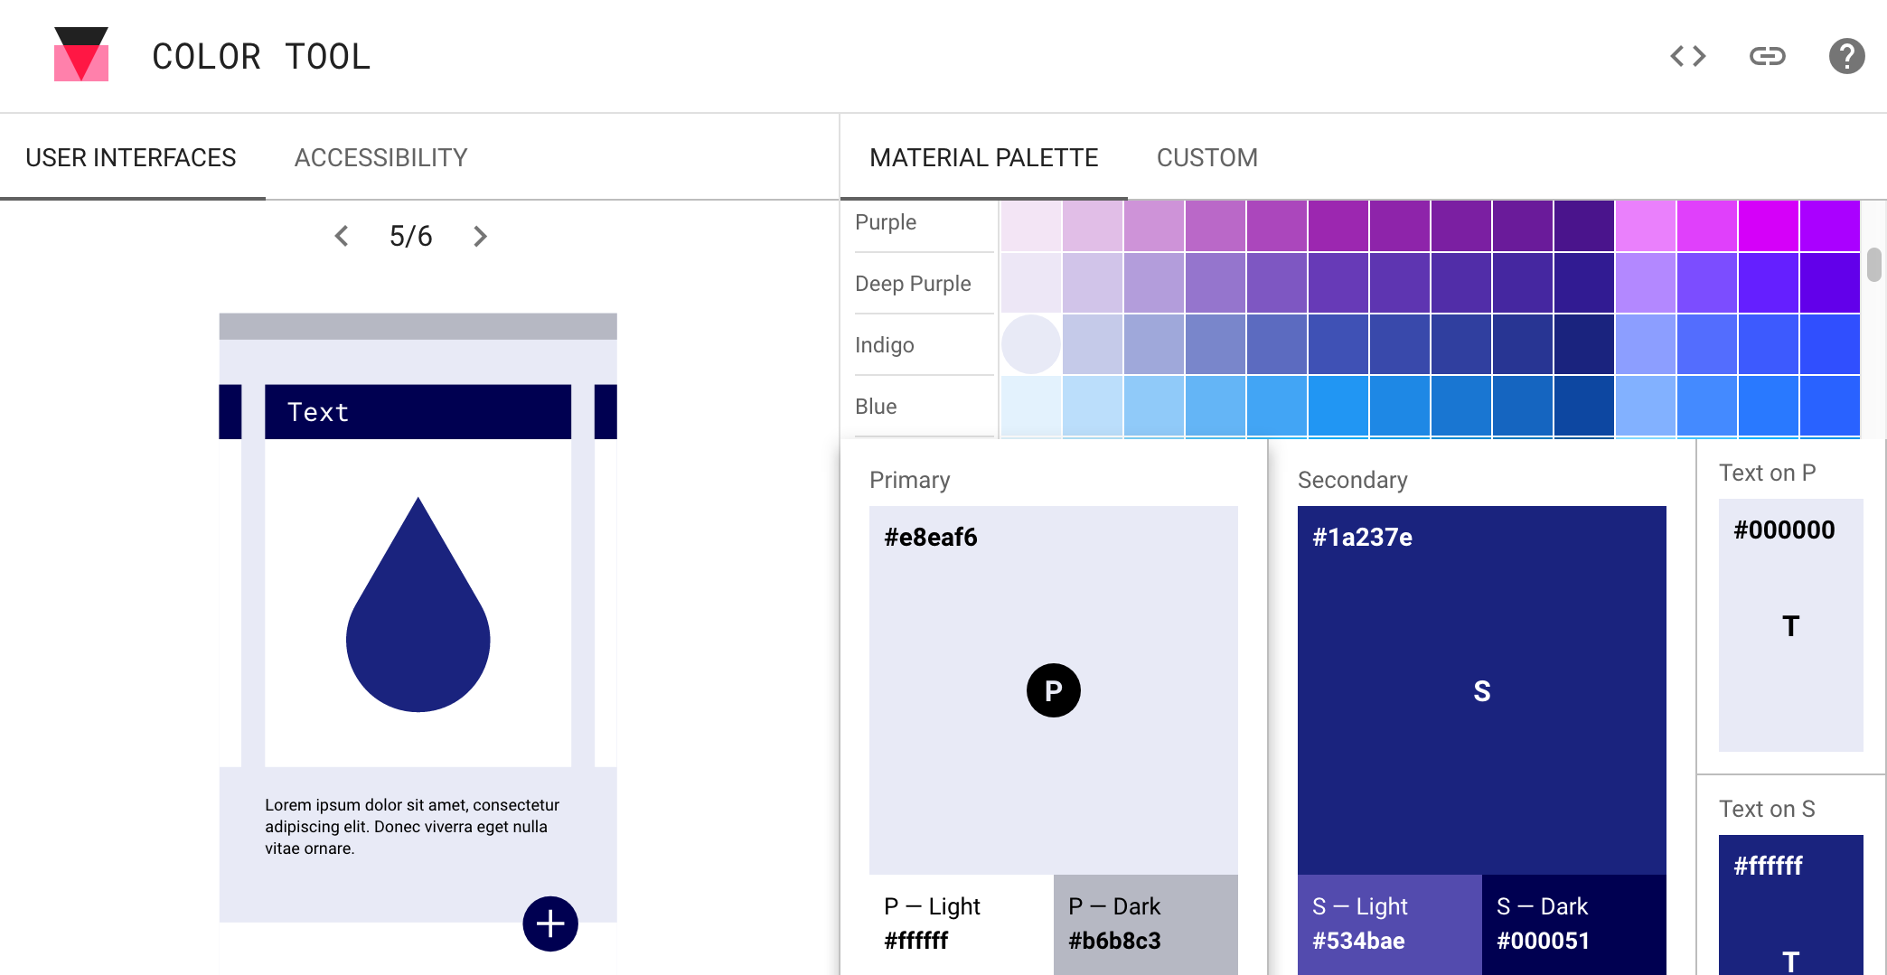
Material Design palette and color tool

Slide 24
Color tool
Use color tool to apply color to your UI
Choose colors and click Accessibility tab in the tool to see legibility warnings
Measure accessibility level of any color combination
Ensure that majority of combinations you choose have right amount of contrast

Slide 25
Contrast
Ensure colors have sufficient contrast between elements
Contrast ratio: the higher the difference, the greater the difference in relative luminance
W3C recommends minimum contrast ratios:
Small text, at least 4.5:1 against background
Large text (14 pt bold/18 pt regular and up), at least 3:1 against background
Logos don't need to meet minimum contrast ratios

Slide 26
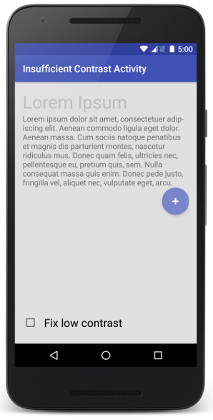
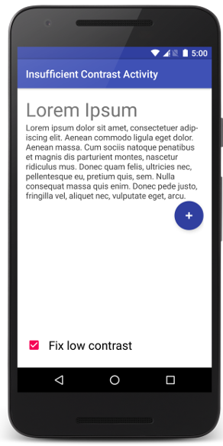
Contrast examples
Bad contrast
Good contrast
Low contrast ratios Title: 1.42 to 1 Content: 3.49 to 1 | Increased contrast ratios Title: 4.61 to 1 Content: 10.05 to 1

Slide 27
Visual clues
Use visual cues for UI elements to help users with color vision deficiencies
Use different shapes or sizes
Provide text or visual patterns
Add audio- or touch-based (haptic) feedback

Slide 28
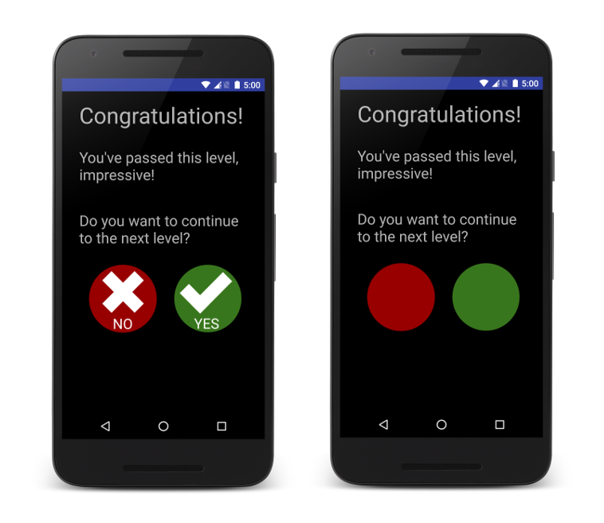
Example of visual clues
Uses shapes and text as well as colors
Uses only colors

Slide 29
Type size
Set type size to help users with vision impairments
Users set font size: Settings > Accessibility > Font size
Specify type as scalable point (sp) units to scale based on user's size setting
Use Android built-in styles for small, medium, and large typefaces
style="@android:style/TextAppearance.Small"

Slide 30
Audio and video
Need to be accessed by people who are hard of hearing
Provide visual alternatives to audio, and audio alternatives to visual
Don't use audio-only feedback
For essential audio feedback and alerts provide
Closed captions
Transcript
Other visual alternative

Slide 31
Testing for accessibility
Find usability issues you might otherwise miss

Slide 32
Tools to test accessibility
Making Apps More Accessible
Google TalkBack: Manual test for touch and spoken feedback
Accessibility Scanner: Provides suggestions
Frameworks: Espresso and Robolectric
Android Testing Support Library includes accessibility
Android Studio lint warnings

Slide 33
Google TalkBack
Android built-in screen reader
Users can interact with device without seeing screen
TalkBack identifies every item you touch on the screen
You can test each view and activity in your app

Slide 34
Manual testing with TalkBack
Turn on TalkBack (Settings > Accessibility > TalkBack)
Confirm permissions and device password
Explore by touch
Scroll lists with a two-finger swipe
Use global and local TalkBack menus
Set text navigation rate (swipe as TalkBack reads text aloud)
Activate EditText views and enter text

Slide 35
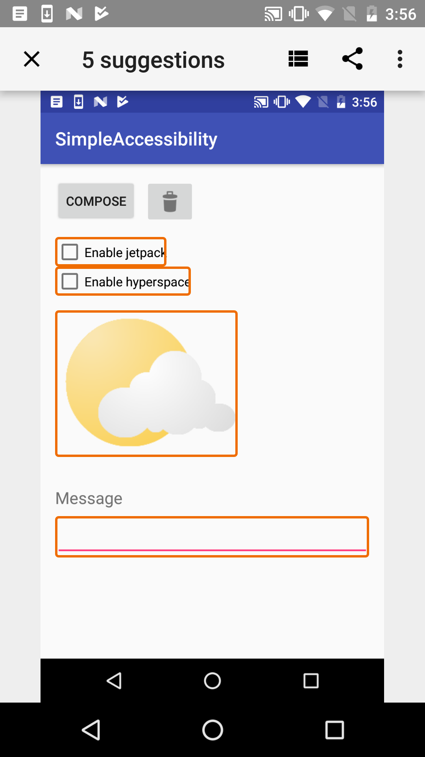
Accessibility Scanner app
Install on device from Google Play
Turn on (Settings > Accessibility >Accessibility Scanner)
Navigate to app and tap Accessibility Scanner
Notes appear about possible improvements to your app

Slide 36
Android Testing Support Library
Configure testing using AccessibilityChecks to enable automated checks in Espresso tests:
AccessibilityChecks.enable();
Checks run when you perform any ViewActions
Check the entire view hierarchy:
AccessibilityChecks.enable().setRunChecksFromRootView(true);

Slide 37
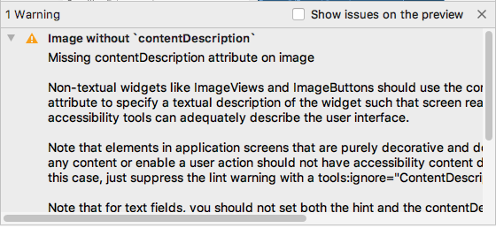
Android Studio lint tool
Android Studio shows lint warnings for accessibility issues
Lint provides link to source code containing issue
Example: If view needs content description, lint warning appears

Slide 38
What's next?
Concept chapter: 6.1 Accessibility
Practicals:
6.1 Exploring accessibility in Android
6.2 Creating accessible apps

Slide 39
END

